Slide 1
Micro Credit Defaulter Project

Slide 2
Contents:
Problem Statement
Definition of Micro Credit
Importance of Micro Credit Model
Exploratory data analysis(EDA)
Visualization
Data cleaning
Model Building
ROC-AUC Curve
Hyper parameter Tuning
How to save the Model
Conclusion

Slide 3
Problem statement:
A Microfinance Institution (MFI) is an organization that offers financial services to low income populations. MFS becomes very useful when targeting especially the unbanked poor families living in remote areas with not much sources of income. The Microfinance services (MFS) provided by MFI are Group Loans, Agricultural Loans, Individual Business Loans and so on.
Many microfinance institutions (MFI), experts and donors are supporting the idea of using mobile financial services (MFS) which they feel are more convenient and efficient, and cost saving, than the traditional high-touch model used since long for the purpose of delivering microfinance services. Though, the MFI industry is primarily focusing on low income families and are very useful in such areas, the implementation of MFS has been uneven with both significant challenges and successes.

Slide 4
We are working with one such client that is in Telecom Industry. They are a fixed wireless telecommunications network provider. They have launched various products and have developed its business and organization based on the budget operator model, offering better products at Lower Prices to all value conscious customers through a strategy of disruptive innovation that focuses on the subscriber.
The Consumer is believed to be defaulter if he deviates from the path of paying back the loaned amount within the time duration of 5 days. For the loan amount of 5 (in Indonesian Rupiah), payback amount should be 6 (in Indonesian Rupiah), while, for the loan amount of 10 (in Indonesian Rupiah), the payback amount should be 12 (in Indonesian Rupiah).
The sample data is provided to us from our client database. It is hereby given to you for this exercise. In order to improve the selection of customers for the credit, the client wants some predictions that could help them in further investment and improvement in selection of customers.

Slide 5
What is Microcredit?
Microcredit is a common form of microfinance that involves an extremely small loan given to an individual to help them become self-employed or grow a small business. These borrowers tend to be low-income individuals, especially from less developed countries (LDCs). Microcredit is also known as "micro lending" or "microloan."

Slide 6
Exploratory data analysis(EDA)
Step 1: Import the dataset
Step 2: Perform statistical analysis like checking the shape and information about the data
Step 3: Check for null values in the dataset
Step 4: Dropped the columns with respect to 30 days and kept only the features with respect to 90 days.
Step 5: Extracted the Day and month from the date column
Step 6: Removed negative values for the fields with respect to number of days.

Slide 7
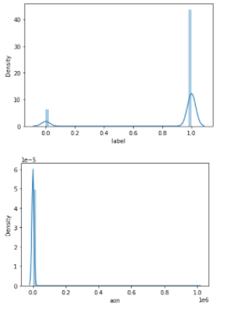
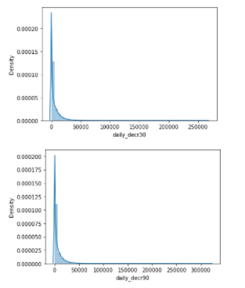
Visualization

Slide 8
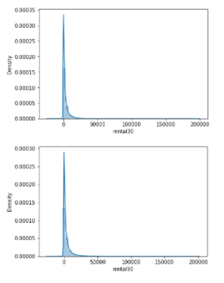
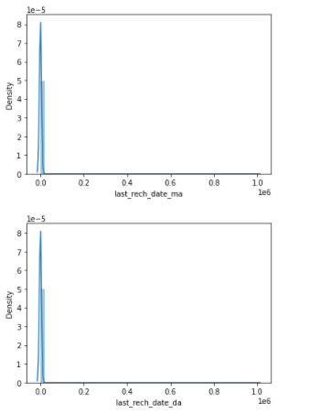
Visualization

Slide 9
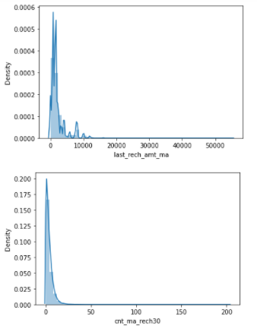
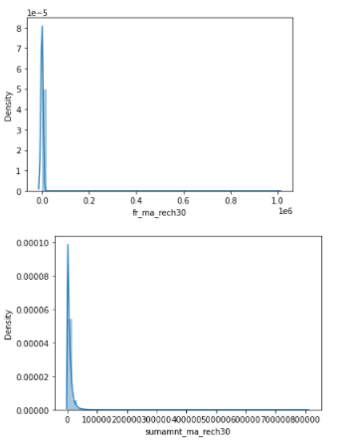
Visualization

Slide 10
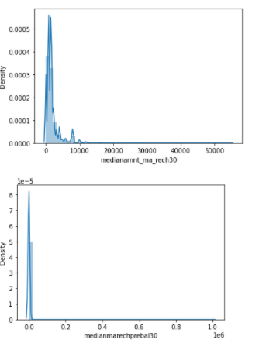
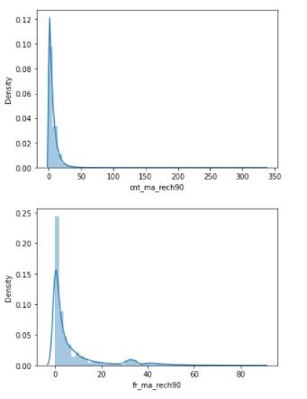
Visualization

Slide 11
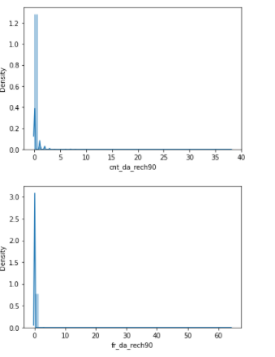
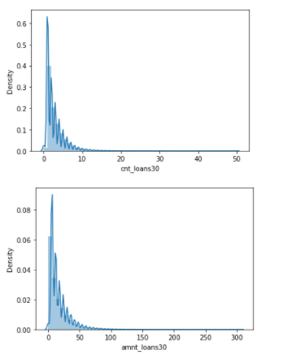
Visualization

Slide 12
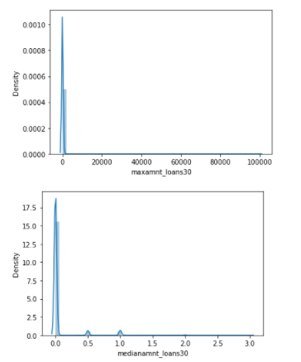
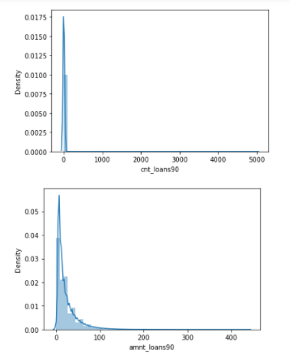
Visualization

Slide 13
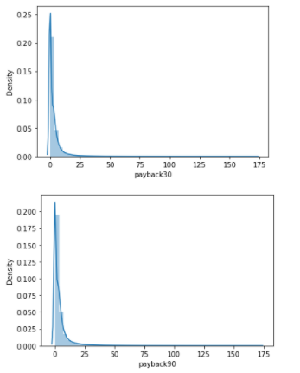
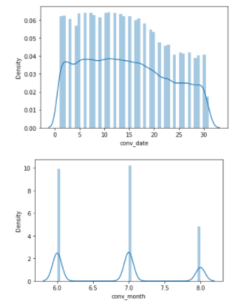
Visualization

Slide 14
From all the above distribution plots we can see that our data for all the features are heavily skewed.

Slide 15
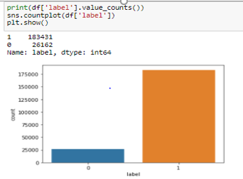
Imbalanced Data:
SMOTE oversampling technique used to solve the imbalanced data.

Slide 16
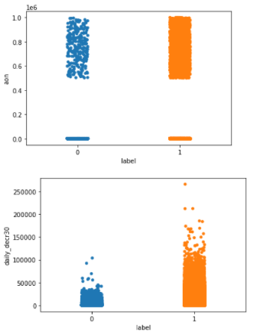
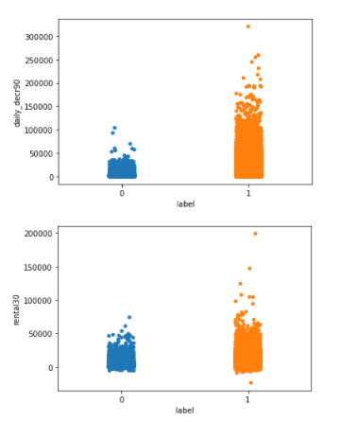
Bivariate analysis

Slide 17
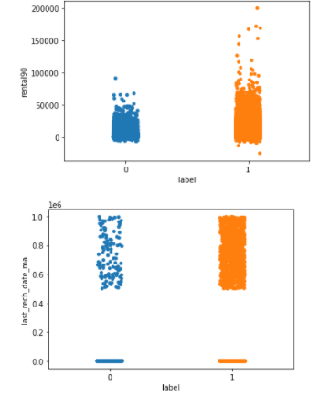
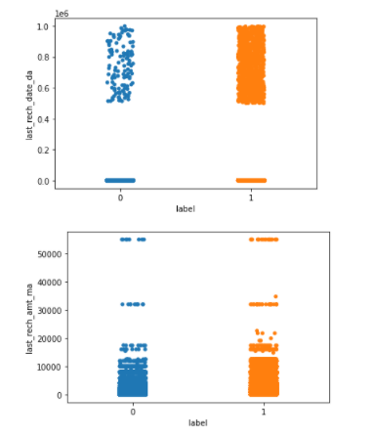
Bivariate analysis

Slide 18
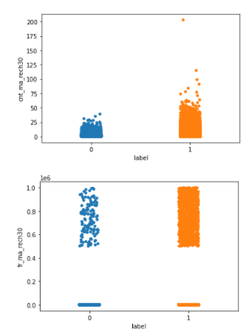
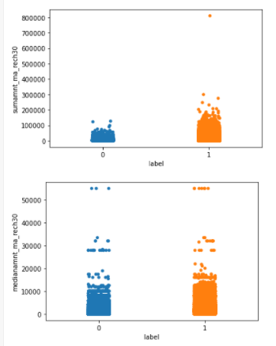
Bivariate analysis

Slide 19
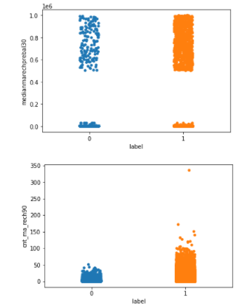
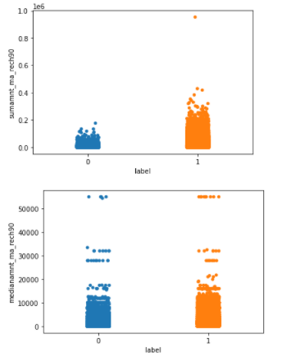
Bivariate analysis

Slide 20
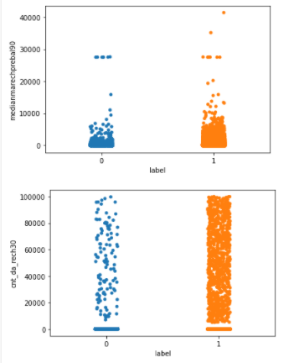
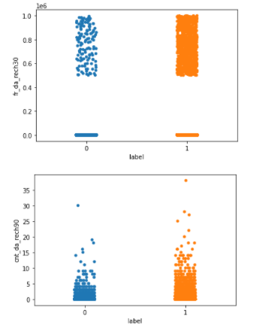
Bivariate analysis

Slide 21
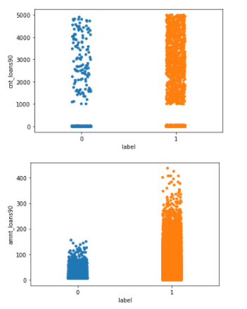
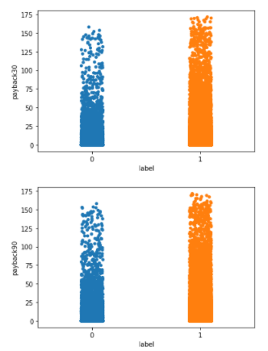
Bivariate analysis

Slide 22
Observations from above plots:
From the above observations its clear that data with respect to 30 days and data with respect to 90 days are almost having the similar kind of relation with the target variable. So, as per my understanding we can keep either of the time period data and I would prefer 90 days as it has more time span and it will be better to understand about customer's info with long time span.
1. Daily amount spent from main account, averaged over last 30 days and last 90 days are less for defaulters(who are not paying loans back within 5 days).
2. Average main account balance over last 30 days and last 90 days are compartively less for defaulters.
3. Number of times main account got recharged in last 30 day and last 90 days are less for defaulters.
4. Total amount of recharge in main account over last 30 days and last 90 days are less for defaulters.
5. Total amount of loans taken by user in last 30 days and last 90 days are less for defaulters

Slide 23
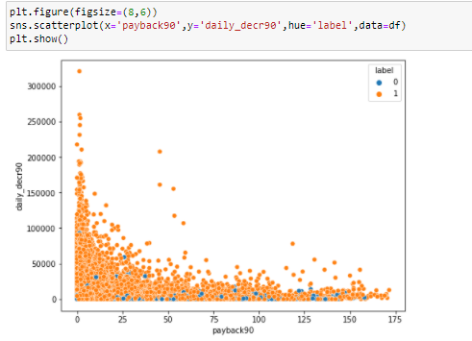
Bivariate analysis
The customers who are spending more amount from their main account on daily basis are most likely to payback the loans within the time period.

Slide 24
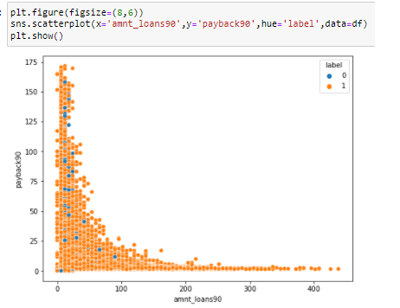
Bivariate analysis
The customers who are taking more loan amount are paying back with less time period.

Slide 25
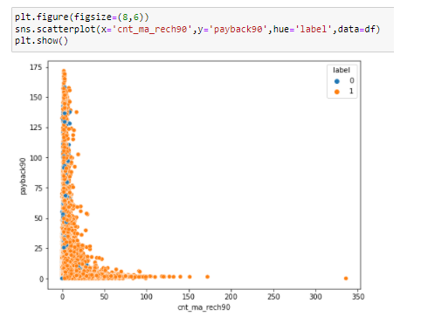
Bivariate analysis
When the customer recharging more number of times for their main account, they are most likely to payback the loans within the time period.

Slide 26
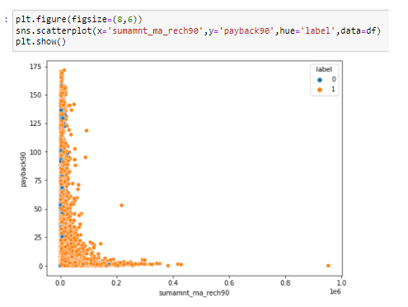
Bivariate analysis
When the total amount of recharge in main account is more, the customer is more likely to payback the loans within the time period.

Slide 27
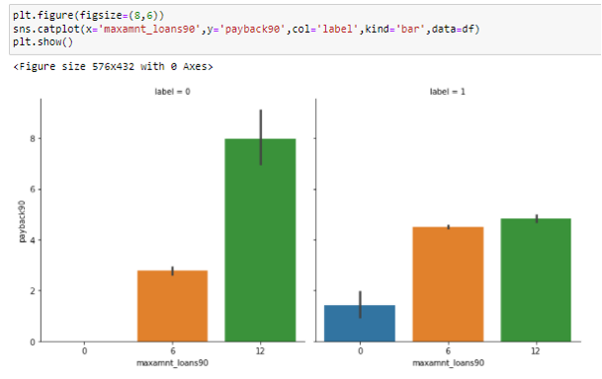
Bivariate analysis
The customers who are taking loan amount of 12 are most likely to be defaulters.

Slide 28
Data cleaning
The dataset that was provided did not have any null values but had a lot of skew data.
I have cleaned few of the non-realistic data with respect to no.of days.
Also cleaned the customer info with no history of loans.
Checked the skewness and reduced the skewness by using PowerTansformer .

Slide 29
Model building
We will now use classification models since out target contains categorical data. The below list algorithms are what I’ve used in my project.
Decision Tree Classifier
Random Forest Classifier
Logistic Regression
Gradient Boosting Classifier
KNeighborsClassifier
AdaBoost Classifier
SVC

Slide 30
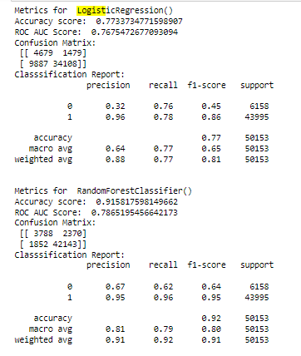
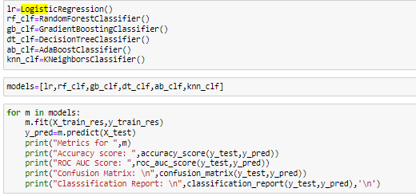

Slide 31
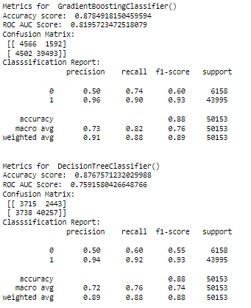
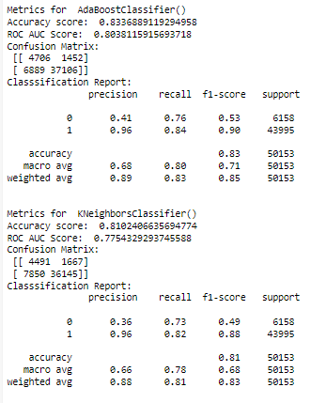

Slide 32
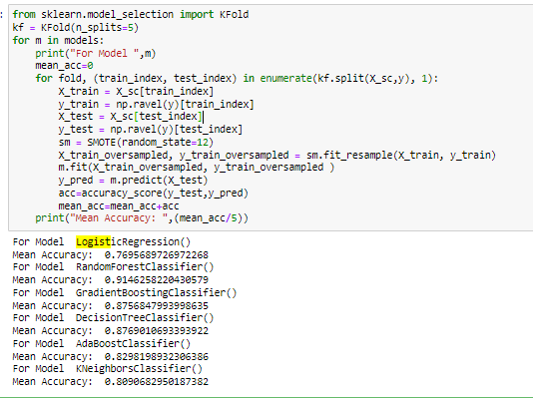
Cross Validation Check

Slide 33
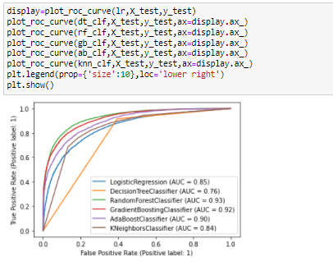
ROC AUC Curve

Slide 34
Conclusion
Based on the base model accuracy score, cross validation score and ROC AUC score, we could finalize RandomForestClassifier as best model for our dataset.

Slide 35
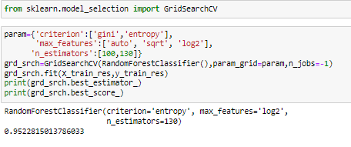
Hyper parameter tuning
Hyper parameter tuning and finding best random state helped to improved accuracy score up to 98%.

Slide 36
Conclusion:
In this project, we have used different classification algorithms to predict if a customer is a credit defaulter or not.
After building different models, we came to conclusion that Random Forest Classifier is the best model for this project and gave us an accuracy score of 98%.
We also saved the best model and printed the prediction results according to our model.

